Slide 1
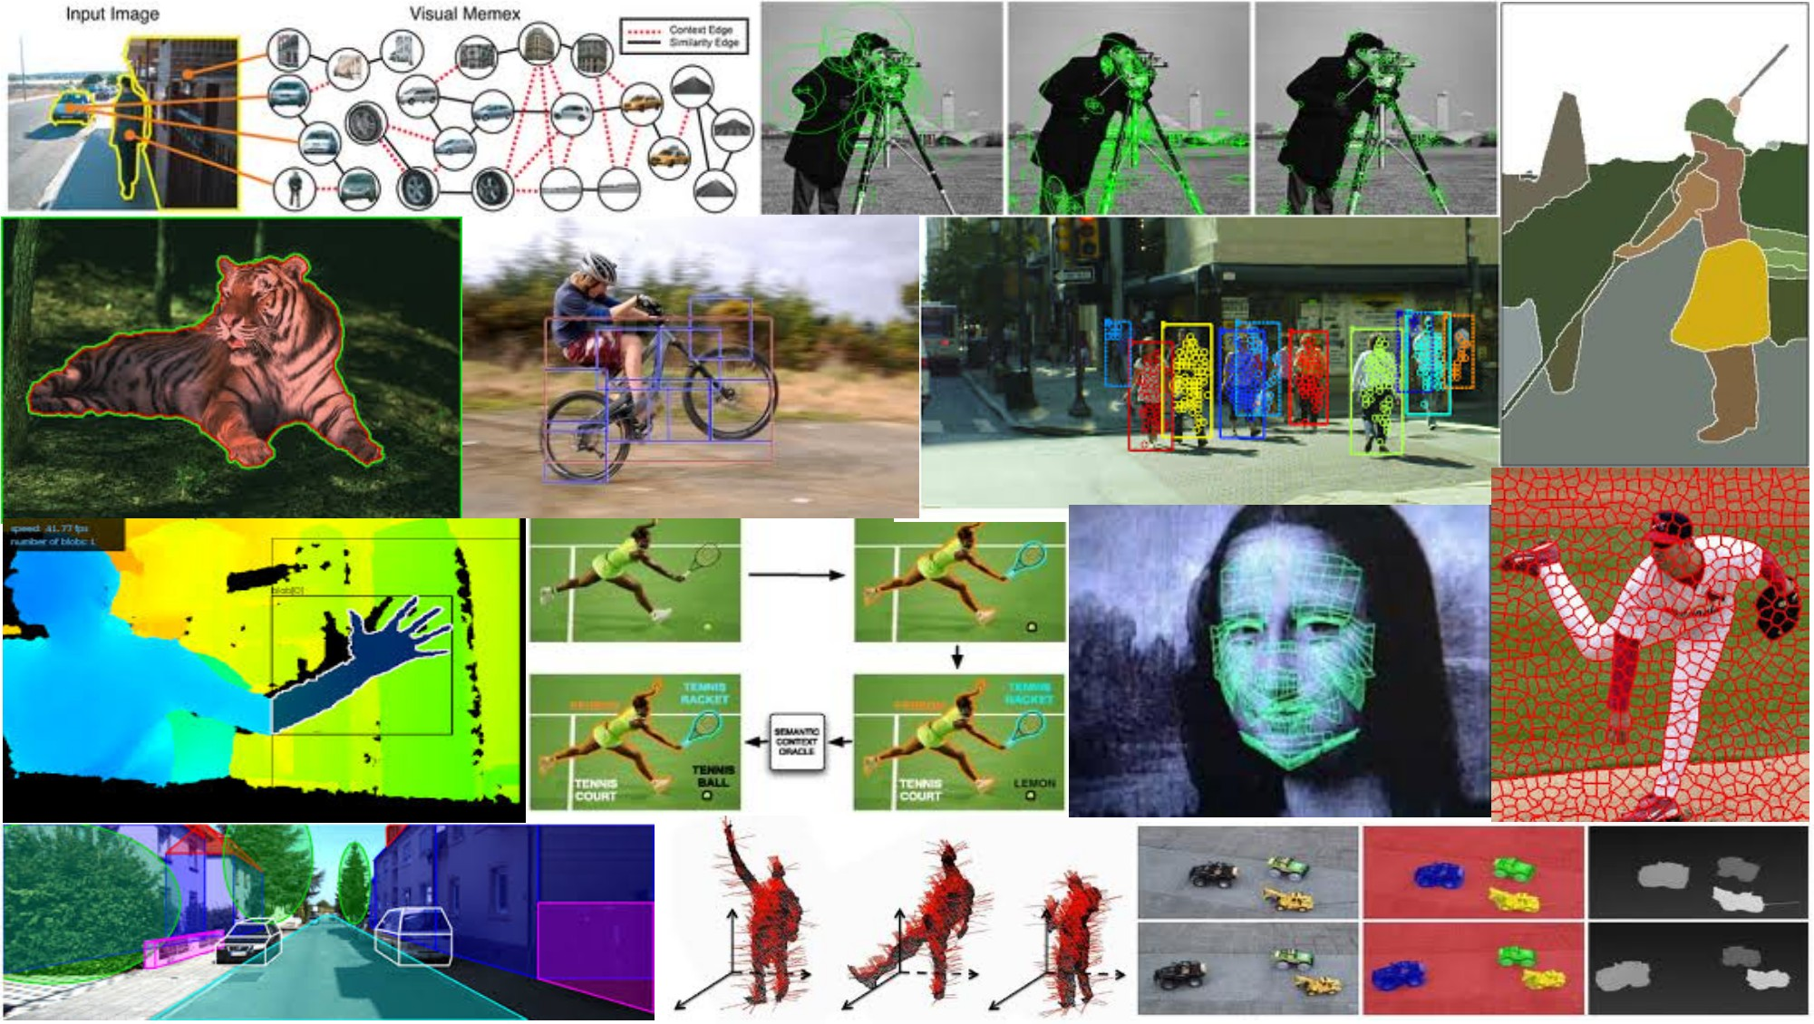
Discriminative classifiers for image recognition May 24th, 2018
Yong Jae Lee
UC Davis

Slide 2
Announcements
PS3 out tonight; due 6/7, 11:59 pm

Slide 3
Outline
Last time: window-based generic object detection
basic pipeline
face detection with boosting as case study

Slide 4
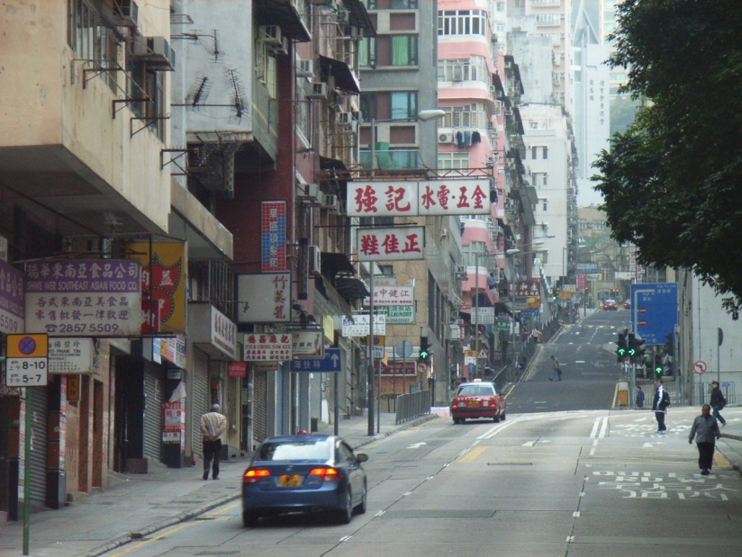

Window-based models Building an object model
Given the representation, train a binary classifier
Car/non-car Classifier
Yes, car.
No, not a car.
Kristen Grauman

Slide 5


Window-based models Generating and scoring candidates
Car/non-car Classifier
Kristen Grauman

Slide 6
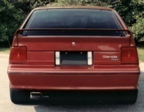
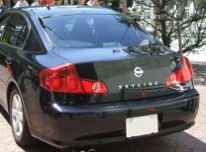

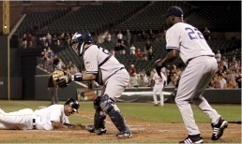
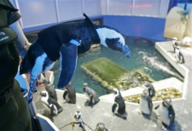
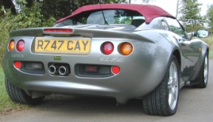
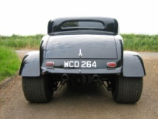

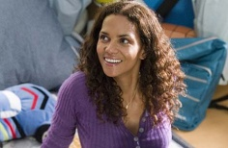


Window-based object detection: recap
Training:
Obtain training data
Define features
Define classifier
Given new image:
Slide window
Score by classifier
Training examples
Car/non-car Classifier
Feature extraction
Kristen Grauman

Slide 7
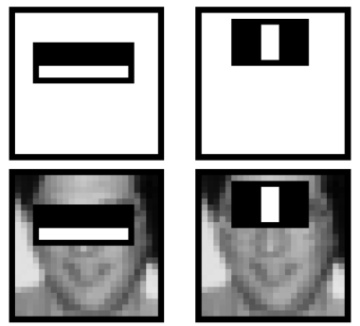
Viola-Jones detector: summary
A seminal approach to real-time object detection
Training is slow, but detection is very fast
Key ideas
Integral images for fast feature evaluation
P. Viola and M. Jones. Rapid object detection using a boosted cascade of simple features. CVPR 2001.
P. Viola and M. Jones. Robust real-time face detection. IJCV 57(2), 2004.

Slide 8
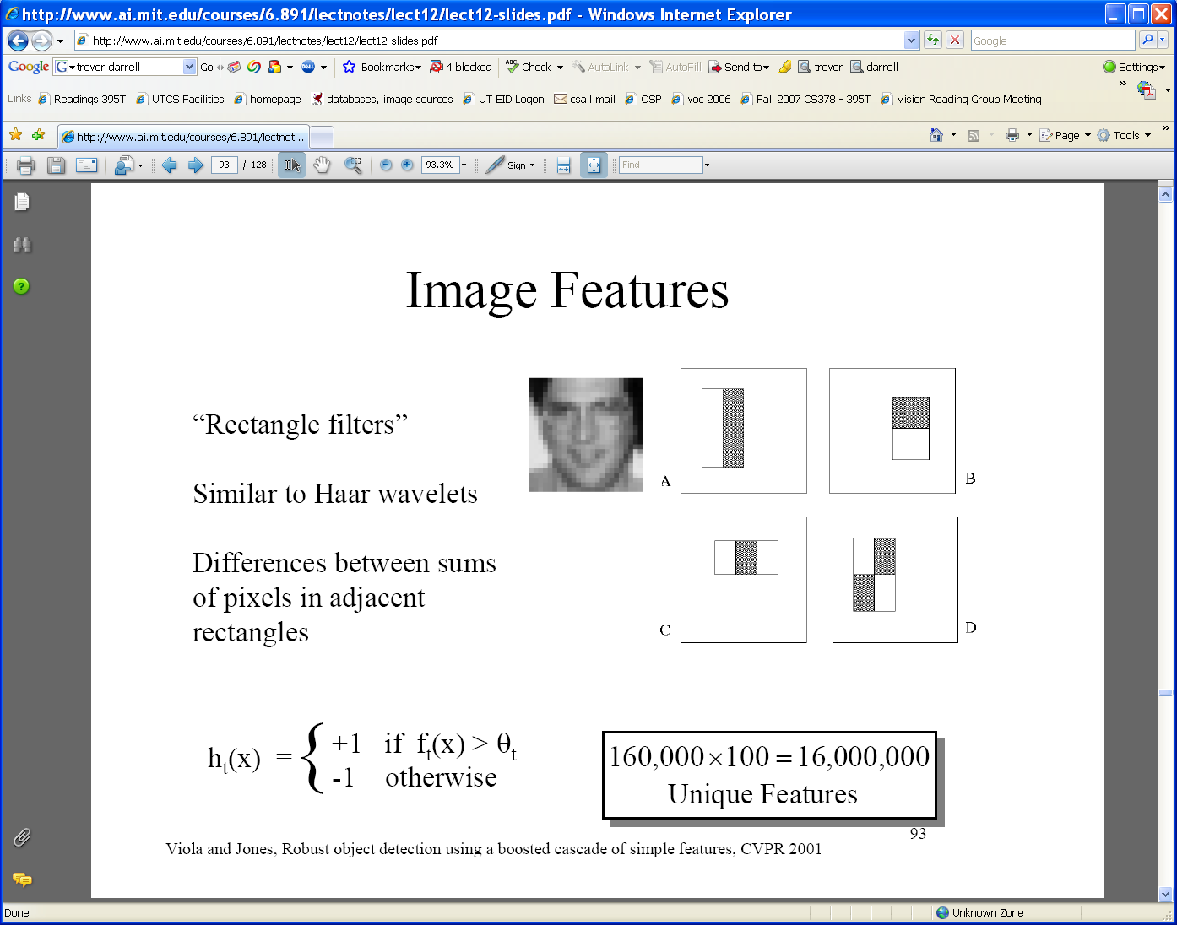
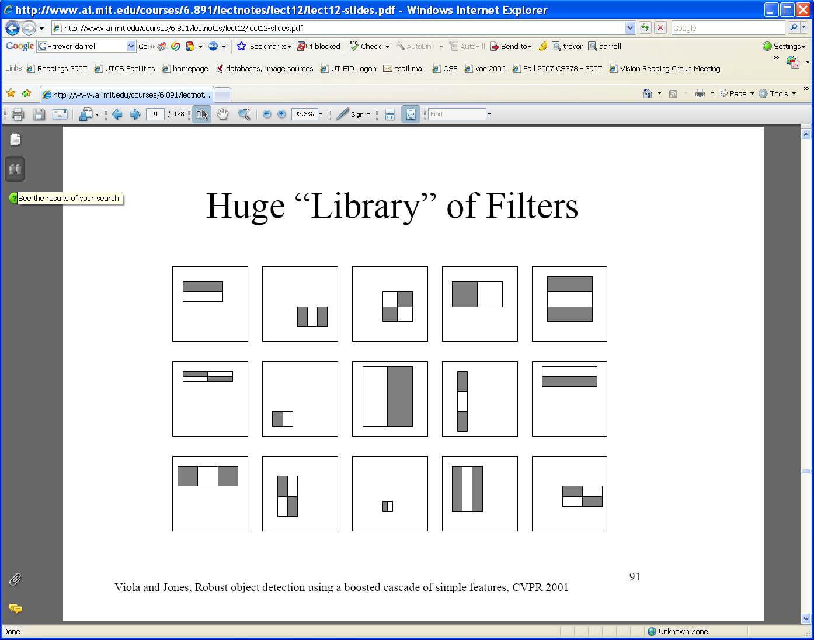
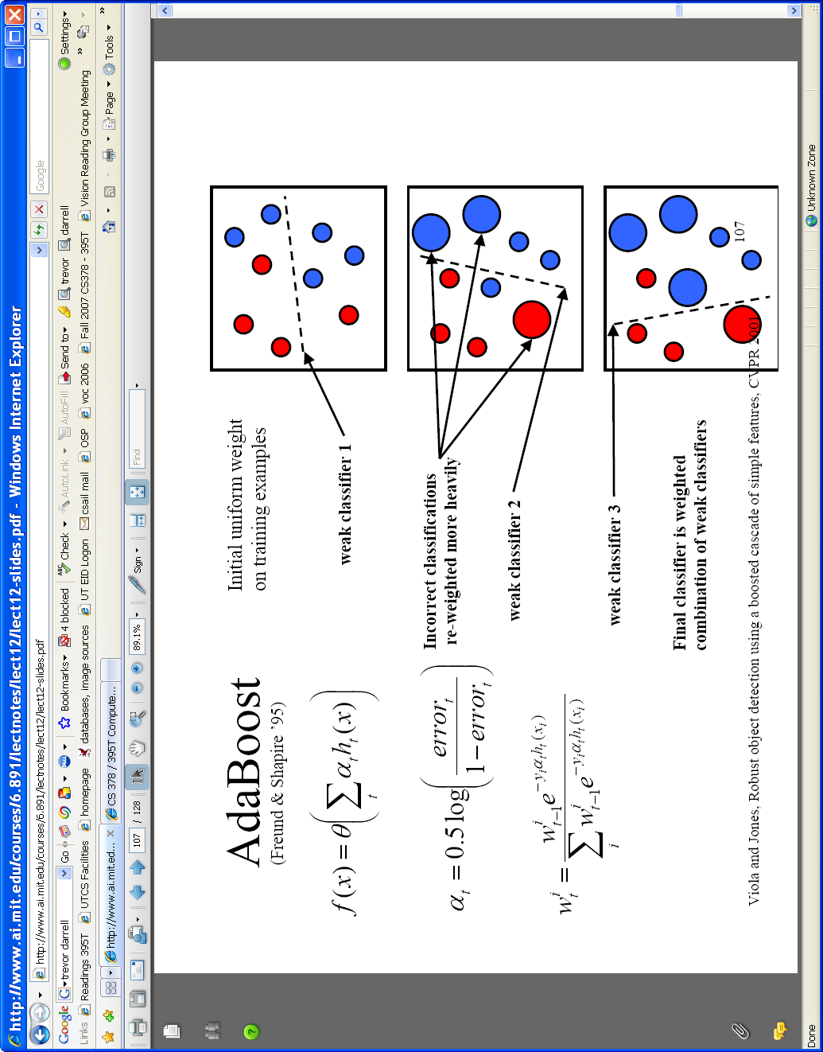
Viola-Jones detector: summary
A seminal approach to real-time object detection
Training is slow, but detection is very fast
Key ideas
Integral images for fast feature evaluation
Boosting for feature selection
P. Viola and M. Jones. Rapid object detection using a boosted cascade of simple features. CVPR 2001.
P. Viola and M. Jones. Robust real-time face detection. IJCV 57(2), 2004.

Slide 9
Viola-Jones detector: summary
A seminal approach to real-time object detection
Training is slow, but detection is very fast
Key ideas
Integral images for fast feature evaluation
Boosting for feature selection
Attentional cascade of classifiers for fast rejection of non-face windows
P. Viola and M. Jones. Rapid object detection using a boosted cascade of simple features. CVPR 2001.
P. Viola and M. Jones. Robust real-time face detection. IJCV 57(2), 2004.

Slide 10
Boosting intuition
Weak
Classifier 1
Slide credit: Paul Viola

Slide 11
Boosting illustration
Weights
Increased

Slide 12
Boosting illustration
Weak
Classifier 2

Slide 13
Boosting illustration
Weights
Increased

Slide 14
Boosting illustration
Weak
Classifier 3

Slide 15
Boosting illustration
Final classifier is
a combination of weak classifiers

Slide 16



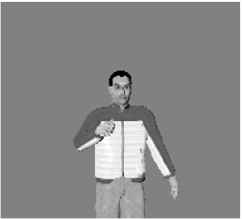

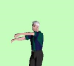


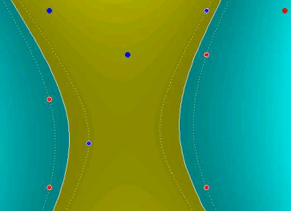
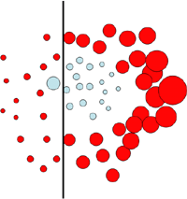
Discriminative classifier construction
Nearest neighbor
Neural networks
10⁶ examples
Shakhnarovich, Viola, Darrell 2003
Berg, Berg, Malik 2005...
LeCun, Bottou, Bengio, Haffner 1998
Rowley, Baluja, Kanade 1998
…
Support Vector Machines
Boosting
Conditional Random Fields
Guyon, Vapnik
Heisele, Serre, Poggio, 2001,…
Viola, Jones 2001, Torralba et al. 2004, Opelt et al. 2006,…
McCallum, Freitag, Pereira 2000; Kumar, Hebert 2003
…
Slide adapted from Antonio Torralba

Slide 17
Discriminative classifier construction
Nearest neighbor
Neural networks
10⁶ examples
Shakhnarovich, Viola, Darrell 2003
Berg, Berg, Malik 2005...
LeCun, Bottou, Bengio, Haffner 1998
Rowley, Baluja, Kanade 1998
…
Support Vector Machines
Boosting
Conditional Random Fields
Guyon, Vapnik
Heisele, Serre, Poggio, 2001,…
Viola, Jones 2001, Torralba et al. 2004, Opelt et al. 2006,…
McCallum, Freitag, Pereira 2000; Kumar, Hebert 2003
…
Slide adapted from Antonio Torralba

Slide 18
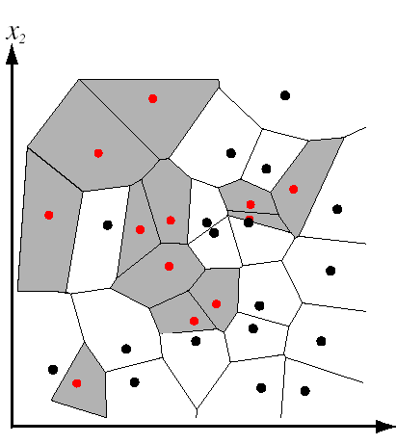
Nearest Neighbor classification
Assign label of nearest training data point to each test data point
Black = negative
Red = positive
Novel test example
Closest to a positive example from the training set, so classify it as positive.
from Duda et al.
Voronoi partitioning of feature space
for 2-category 2D data

Slide 19
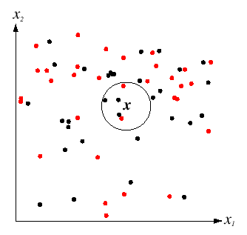
K-Nearest Neighbors classification
For a new point, find the k closest points from training data
Labels of the k points “vote” to classify
k = 5
Black = negative
Red = positive
If query lands here, the 5 NN consist of 3 negatives and 2 positives, so we classify it as negative.
Source: D. Lowe

Slide 20
A nearest neighbor recognition example

Slide 21
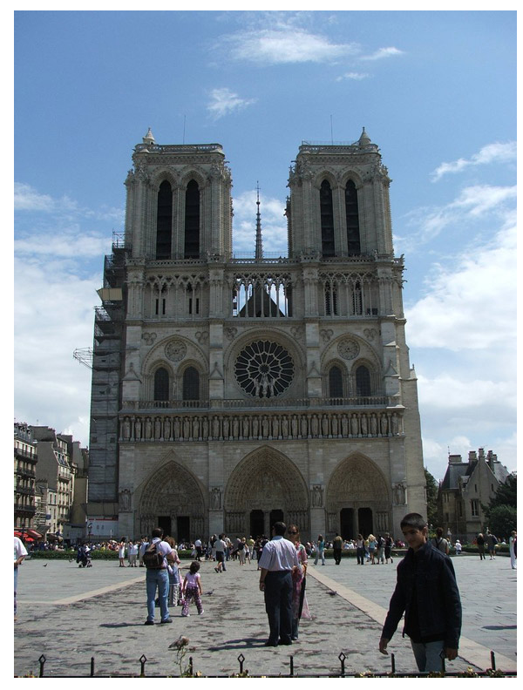
Where in the World?
[Hays and Efros. im2gps: Estimating Geographic Information from a Single Image. CVPR 2008.]
Slides: James Hays
Notes:
an iconic image of the Notre Dame cathedral in Paris

Slide 22
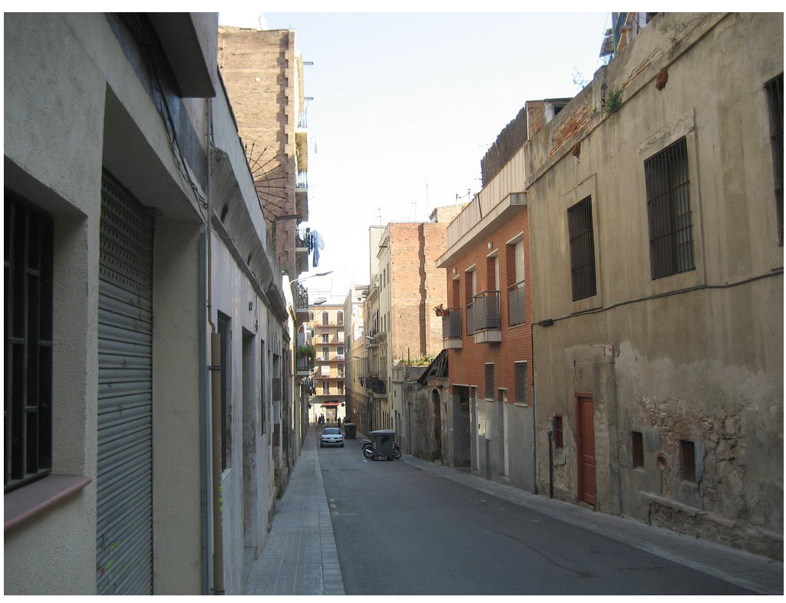
Where in the World?
Slides: James Hays
Notes:
looks vaguely Mediterranean, perhaps a small town in Italy, or France, or Spain.

Slide 23
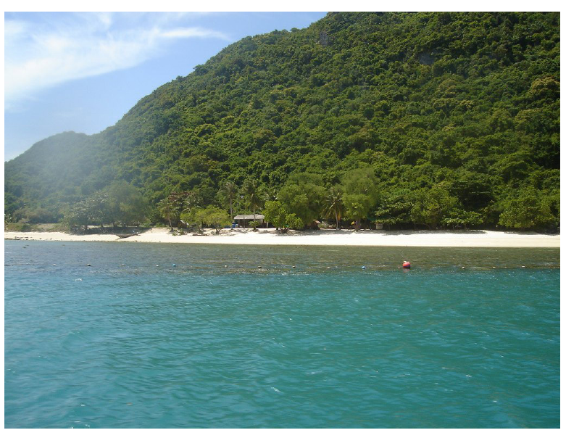
Where in the World?
Slides: James Hays
Notes:
Most ambiguous. Probably all that could be said is that it’s a picture of a seaside in some tropical location. But note that even this vague description allows us to disregard all non-coastal, non-tropical areas – more than 99.9% of the Earth’s surface!

Slide 24
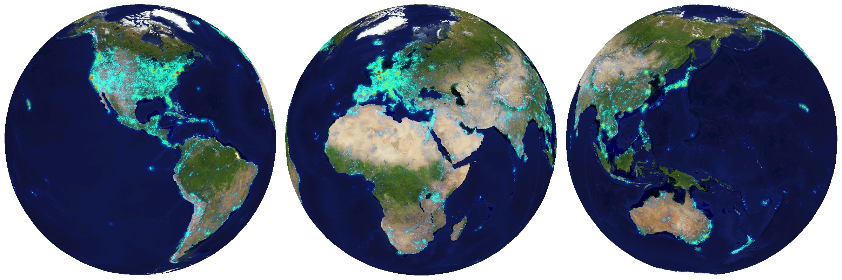
6+ million geotagged photos by 109,788 photographers
Annotated by Flickr users
Slides: James Hays
Notes:
images with both GPS coordinates and geographic keywords
Our list of geographic keywords includes every country and territory, every continent, the top 200 most populated cities in the world, every US state, and popular tourist sites (e.g. “Pisa”, “Nikko”, “Orlando”).

Slide 25
6+ million geotagged photos by 109,788 photographers
Annotated by Flickr users
Slides: James Hays
Notes:
images with both GPS coordinates and geographic keywords
Our list of geographic keywords includes every country and territory, every continent, the top 200 most populated cities in the world, every US state, and popular tourist sites (e.g. “Pisa”, “Nikko”, “Orlando”).

Slide 26
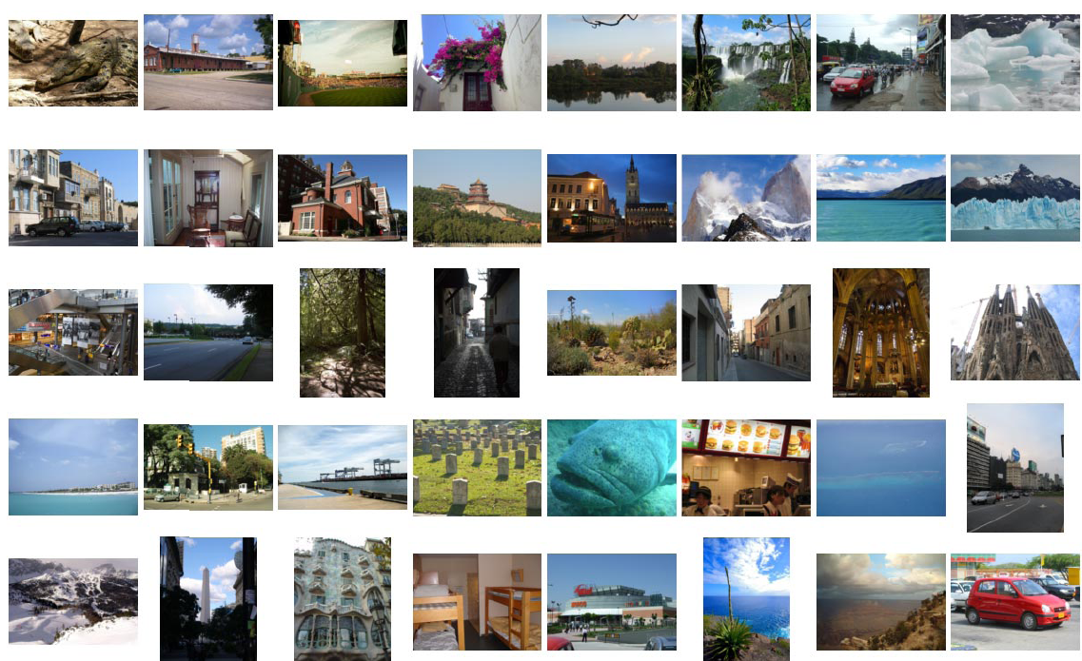
Quantitative Evaluation Test Set
…
Notes:
We built the test set by drawing 400 random images from the original data set

Slide 27
Which scene properties are relevant?

Slide 28

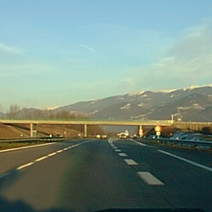
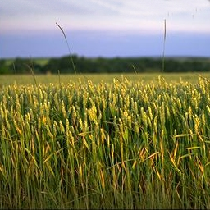
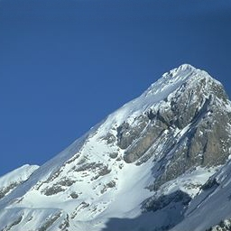
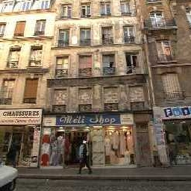
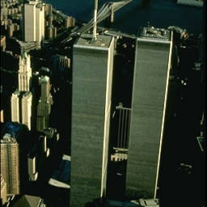
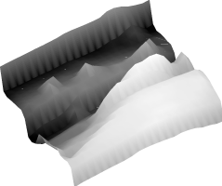


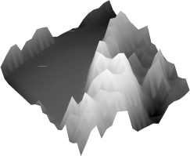
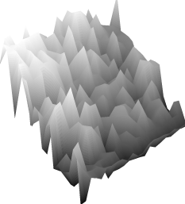
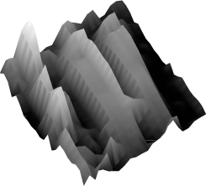
Spatial Envelope Theory of Scene Representation Oliva & Torralba (2001)
A scene is a single surface that can be
represented by global (statistical) descriptors
Slide Credit: Aude Olivia

Slide 29
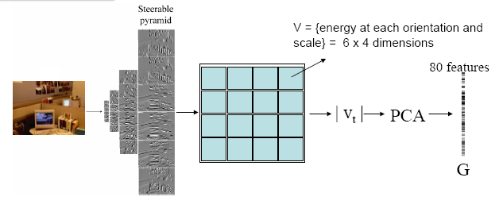
Global texture: capturing the “Gist” of the scene
Capture global image properties while keeping some spatial information
Gist descriptor
Oliva & Torralba IJCV 2001, Torralba et al. CVPR 2003
Notes:
The gist descriptor has been shown to work well for scene categorization and for retrieving semantically and structurally similar scenes

Slide 30
Which scene properties are relevant?
Gist scene descriptor
Color Histograms - L*A*B* 4x14x14 histograms
Texton Histograms – 512 entry, filter bank based
Line Features – Histograms of straight line stats
Notes:
Texture features might help distinguish between geographically correlated properties such as building materials in cities or vegetation and terrain types in landscapes.
Line features are useful for distinguishing between natural and man-made scenes and for finding scenes with similar vanishing points. For each image we build two histograms based on the statistics of detected lines- one with bins corresponding to line angles and one with bins corresponding to line lengths

Slide 31
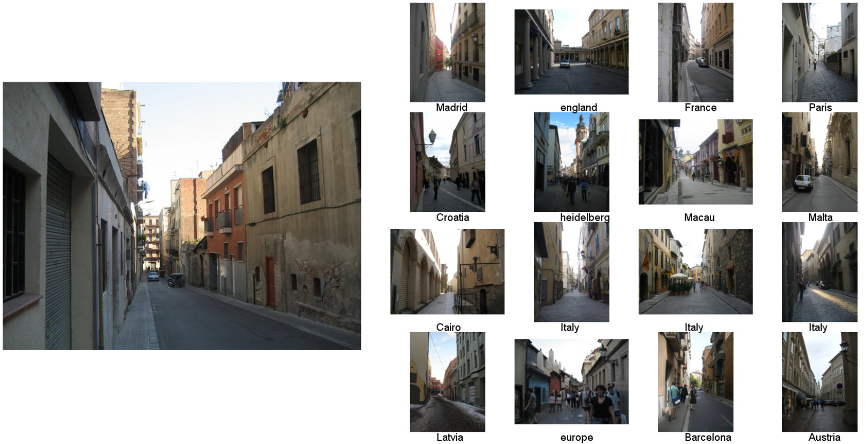
Im2GPS: Scene Matches
Slides: James Hays
[Hays and Efros. im2gps: Estimating Geographic Information from a Single Image. CVPR 2008.]

Slide 32
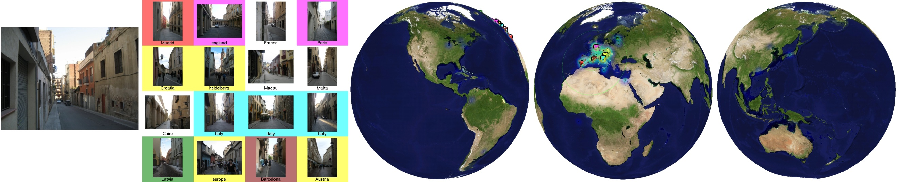

Slides: James Hays

Slide 33
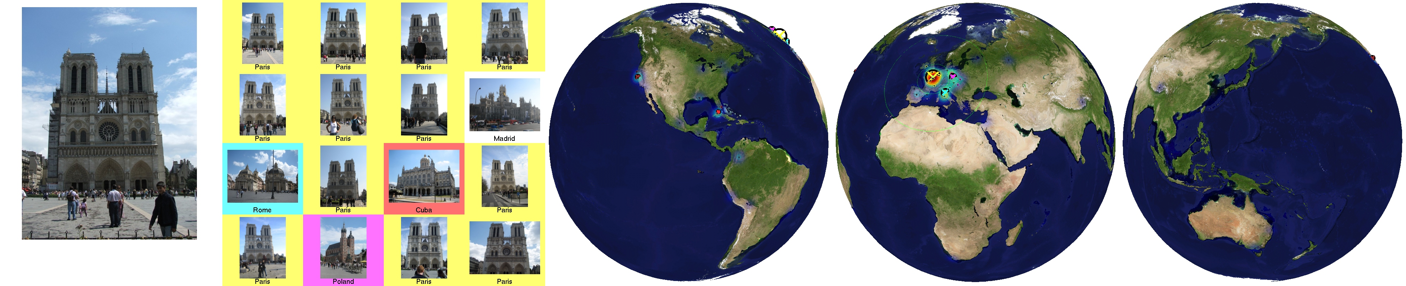
Im2GPS: Scene Matches
Slides: James Hays
[Hays and Efros. im2gps: Estimating Geographic Information from a Single Image. CVPR 2008.]

Slide 34

Slides: James Hays
[Hays and Efros. im2gps: Estimating Geographic Information from a Single Image. CVPR 2008.]
Notes:
If a scene match is contained in a cluster it is highlighted with the corresponding color. The ground truth location is a cyan asterisk surrounding by green contours at radii of 200km, 750km, and 2500km.

Slide 35

Im2GPS: Scene Matches
Slides: James Hays
[Hays and Efros. im2gps: Estimating Geographic Information from a Single Image. CVPR 2008.]

Slide 36


Slides: James Hays
[Hays and Efros. im2gps: Estimating Geographic Information from a Single Image. CVPR 2008.]

Slide 37
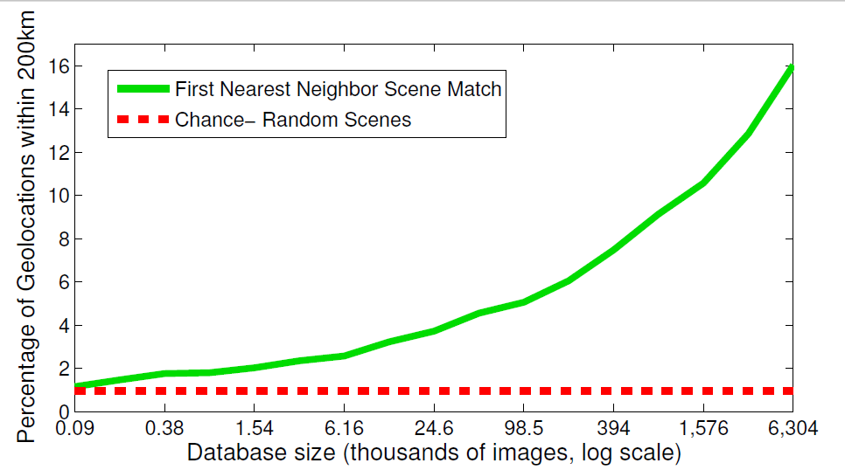
The Importance of Data
[Hays and Efros. im2gps: Estimating Geographic Information from a Single Image. CVPR 2008.]
Slides: James Hays
Notes:
With a tiny database of 90 images, the 1-NN scene match is as likely to be near the query as a random image from the database. With the full database we perform 18 times better than chance.
Note that the percentage of test cases geolocated to within 200km (16%) is significantly higher than the proportion of “landmark” images (e.g. Notre Dame) in the test set (about 5%).

Slide 38
Nearest neighbors: pros and cons
Pros:
Simple to implement
Flexible to feature / distance choices
Naturally handles multi-class cases
Can do well in practice with enough representative data
Cons:
Large search problem to find nearest neighbors (slow during testing)
Storage of data
Must have a meaningful distance function

Slide 39
Outline
Discriminative classifiers
Boosting (last time)
Nearest neighbors
Support vector machines

Slide 40
Linear classifiers

Slide 41
Lines in R²
Let

Slide 42
Lines in R²
Let

Slide 43
Lines in R²
Let

Slide 44
Lines in R²
Let
distance from point to line

Slide 45
Lines in R²
Let
distance from point to line

Slide 46
Linear classifiers
Find linear function to separate positive and negative examples
Which line is best?

Slide 47
Support Vector Machines (SVMs)
Discriminative classifier based on optimal separating line (for 2d case)
Maximize the margin between the positive and negative training examples

Slide 48
Support vector machines
Want line that maximizes the margin.
wx+b=1
wx+b=0
wx+b=-1
For support vectors,
Support vectors
Margin
C. Burges, A Tutorial on Support Vector Machines for Pattern Recognition, Data Mining and Knowledge Discovery, 1998

Slide 49
Support vector machines
Want line that maximizes the margin.
wx+b=1
wx+b=0
wx+b=-1
For support vectors,
Distance between point and line:
For support vectors:
Support vectors
Margin M

Slide 50
Support vector machines
Want line that maximizes the margin.
wx+b=1
wx+b=0
wx+b=-1
For support vectors,
Distance between point and line:
Therefore, the margin is 2 / ||w||
Support vectors
Margin M

Slide 51
Finding the maximum margin line
Maximize margin 2/||w||
Correctly classify all training data points:
Quadratic optimization problem:
Minimize Subject to y_{i}(w·x_{i}+b) ≥ 1
C. Burges, A Tutorial on Support Vector Machines for Pattern Recognition, Data Mining and Knowledge Discovery, 1998

Slide 52
Finding the maximum margin line
Solution:
learned weight
Support vector
C. Burges, A Tutorial on Support Vector Machines for Pattern Recognition, Data Mining and Knowledge Discovery, 1998

Slide 53
Finding the maximum margin line
Solution: b = y_{i} – w·x_{i} (for any support vector)
Classification function:
If f(x) < 0, classify as negative, if f(x) > 0, classify as positive
C. Burges, A Tutorial on Support Vector Machines for Pattern Recognition, Data Mining and Knowledge Discovery, 1998

Slide 54
Questions
What if the features are not 2d?
What if the data is not linearly separable?
What if we have more than just two categories?

Slide 55
Questions
What if the features are not 2d?
Generalizes to d-dimensions – replace line with “hyperplane”
What if the data is not linearly separable?
What if we have more than just two categories?

Slide 56
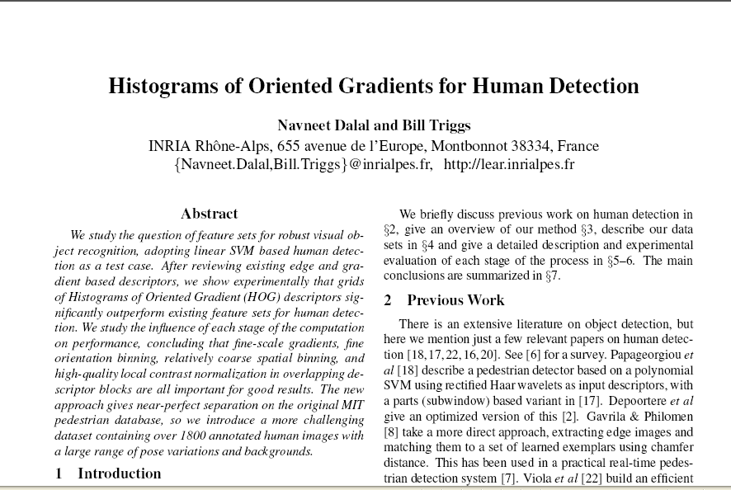
CVPR 2005
22877 citations

Slide 57

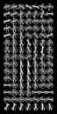
Person detection with HoG’s & linear SVM’s
Map each grid cell in the input window to a histogram counting the gradients per orientation.
Train a linear SVM using training set of pedestrian vs. non-pedestrian windows.
Dalal & Triggs, CVPR 2005

Slide 58
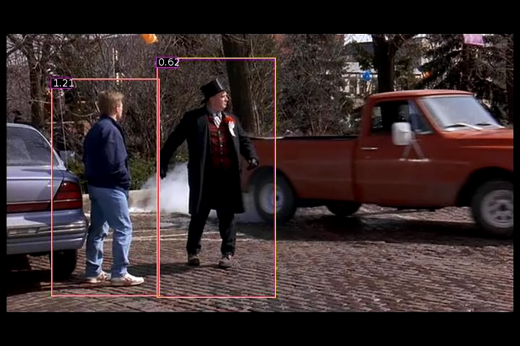
Person detection with HoG’s & linear SVM’s
Histograms of Oriented Gradients for Human Detection, Navneet Dalal, Bill Triggs, International Conference on Computer Vision & Pattern Recognition - June 2005

Slide 59
Questions
What if the features are not 2d?
What if the data is not linearly separable?
What if we have more than just two categories?

Slide 60
Non-linear SVMs
Datasets that are linearly separable with some noise work out great:
But what are we going to do if the dataset is just too hard?
How about… mapping data to a higher-dimensional space:
0
x
0
x
x²
0
x

Slide 61
Non-linear SVMs: feature spaces
General idea: the original input space can be mapped to some higher-dimensional feature space where the training set is linearly separable:
Φ: x → φ(x)
Slide from Andrew Moore’s tutorial: http://www.autonlab.org/tutorials/svm.html

Slide 62
The “Kernel Trick”
The linear classifier relies on dot product between vectors K(x_{i},x_{j})=x_{i}^{T}x_{j}
Slide from Andrew Moore’s tutorial: http://www.autonlab.org/tutorials/svm.html

Slide 63
Finding the maximum margin line
Solution: b = y_{i} – w·x_{i} (for any support vector)
C. Burges, A Tutorial on Support Vector Machines for Pattern Recognition, Data Mining and Knowledge Discovery, 1998

Slide 64
The “Kernel Trick”
The linear classifier relies on dot product between vectors K(x_{i},x_{j})=x_{i}^{T}x_{j}
If every data point is mapped into high-dimensional space via some transformation Φ: x → φ(x), the dot product becomes:
K(x_{i},x_{j})= φ(x_{i}) ^{T}φ(x_{j})
A kernel function is similarity function that corresponds to an inner product in some expanded feature space.
Slide from Andrew Moore’s tutorial: http://www.autonlab.org/tutorials/svm.html

Slide 65
Example
2-dimensional vectors x=[x₁ x₂];
let K(x_{i},x_{j})=(1 + x_{i}^{T}x_{j})²
Need to show that K(x_{i},x_{j})= φ(x_{i}) ^{T}φ(x_{j}):
K(x_{i},x_{j})=(1 + x_{i}^{T}x_{j})²,
= 1+ x_{i1}²x_{j1}² + 2 x_{i1}x_{j1} x_{i2}x_{j2}+ x_{i2}²x_{j2}² + 2x_{i1}x_{j1} + 2x_{i2}x_{j2}
= [1 x_{i1}² √2 x_{i1}x_{i2} x_{i2}² √2x_{i1} √2x_{i2}]^{T}
[1 x_{j1}² √2 x_{j1}x_{j2} x_{j2}² √2x_{j1} √2x_{j2}]
= φ(x_{i}) ^{T}φ(x_{j}),
where φ(x) = [1 x₁² √2 x₁x₂ x₂² √2x₁ √2x₂]
from Andrew Moore’s tutorial: http://www.autonlab.org/tutorials/svm.html

Slide 66
Nonlinear SVMs
The kernel trick: instead of explicitly computing the lifting transformation φ(x), define a kernel function K such that K(x_{i} , x_{j}) = φ(x_{i} ) · φ(x_{j})

Slide 67
Finding the maximum margin line
Solution: b = y_{i} – w·x_{i} (for any support vector)
C. Burges, A Tutorial on Support Vector Machines for Pattern Recognition, Data Mining and Knowledge Discovery, 1998

Slide 68
Nonlinear SVMs
The kernel trick: instead of explicitly computing the lifting transformation φ(x), define a kernel function K such that K(x_{i} , x_{j}) = φ(x_{i} ) · φ(x_{j})
This gives a nonlinear decision boundary in the original feature space:

Slide 69
Examples of kernel functions
Linear:
Gaussian RBF:
Histogram intersection:

Slide 70
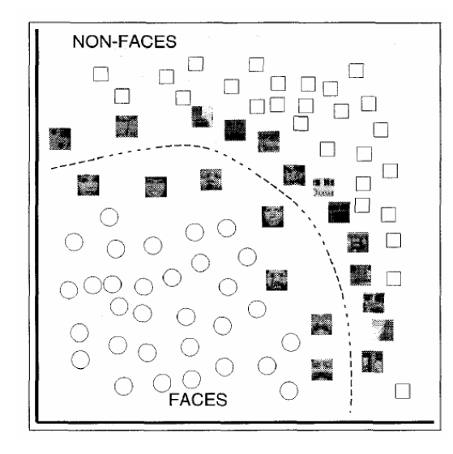
SVMs for recognition
Define your representation for each example.
Select a kernel function.
Compute pairwise kernel values between labeled examples (i.e., training data).
Use this “kernel matrix” to solve for SVM support vectors & weights.
To classify a new test example: compute kernel values between new input and support vectors, apply weights, check sign of output.

Slide 71
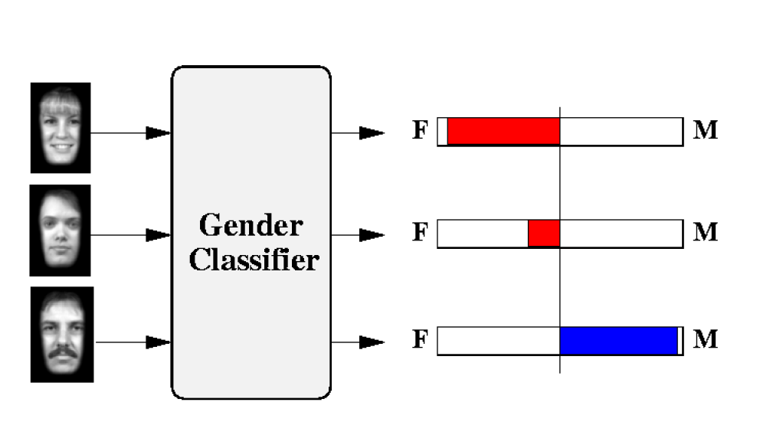
Example: learning gender with SVMs
Moghaddam and Yang, Learning Gender with Support Faces, TPAMI 2002.
Moghaddam and Yang, Face & Gesture 2000.

Slide 72
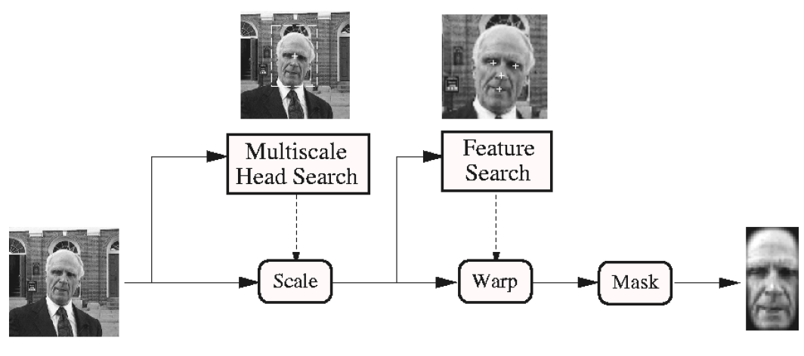
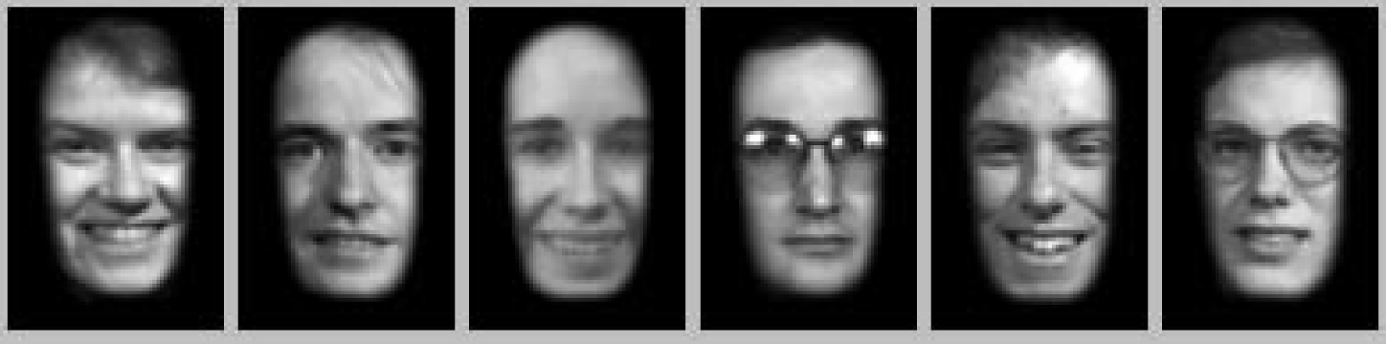
Face alignment processing
Processed faces
Moghaddam and Yang, Learning Gender with Support Faces, TPAMI 2002.

Slide 73
Learning gender with SVMs
Training examples:
1044 males
713 females
Experiment with various kernels, select Gaussian RBF

Slide 74
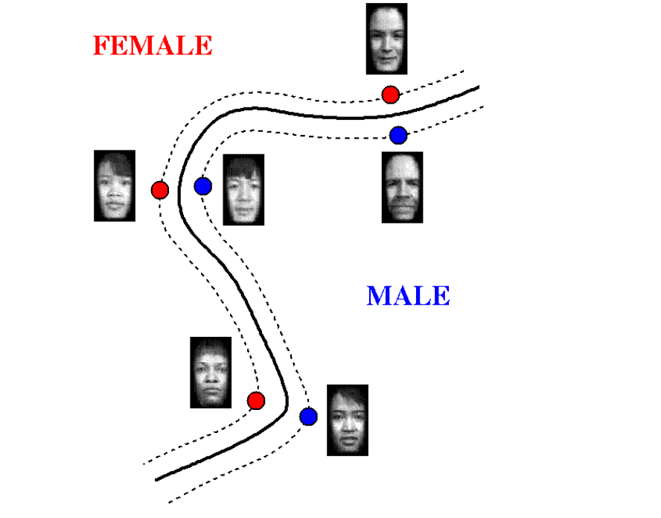
Support Faces
Moghaddam and Yang, Learning Gender with Support Faces, TPAMI 2002.

Slide 75
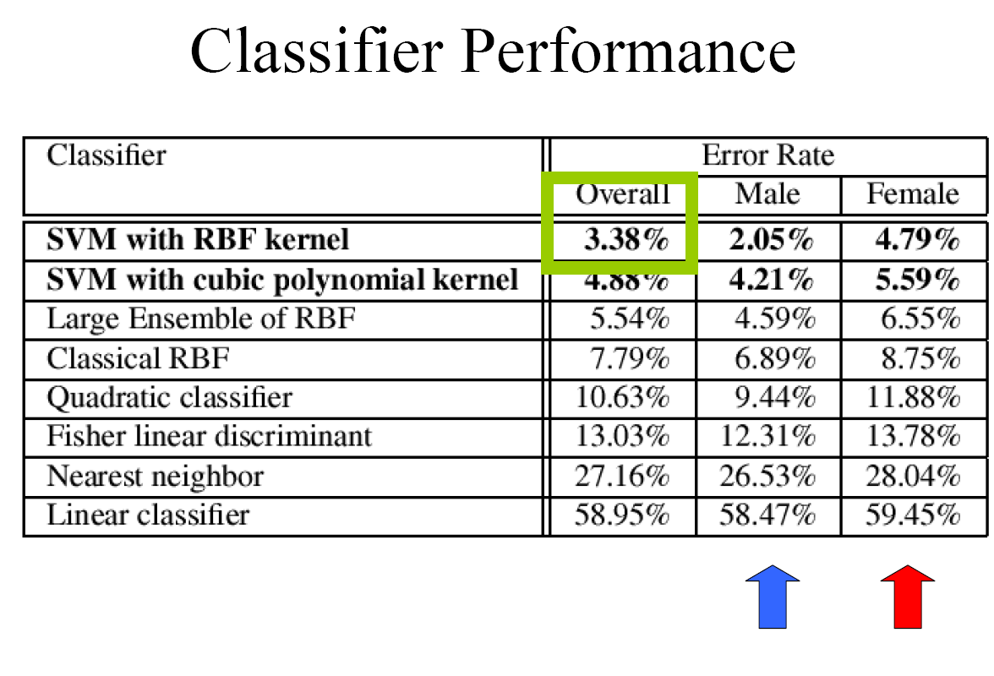
Moghaddam and Yang, Learning Gender with Support Faces, TPAMI 2002.

Slide 76
Gender perception experiment: How well can humans do?
Subjects:
30 people (22 male, 8 female)
Ages mid-20’s to mid-40’s
Test data:
254 face images
Low res
High res
Task:
Classify as male or female, forced choice
No time limit
Moghaddam and Yang, Face & Gesture 2000.

Slide 77
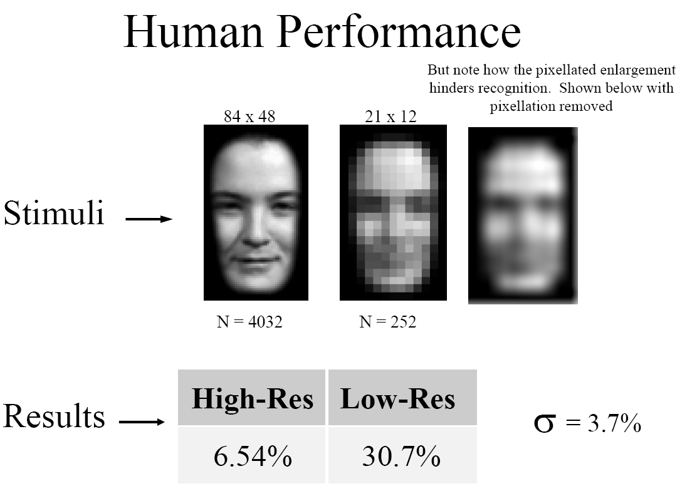
Gender perception experiment: How well can humans do?
Error
Error
Moghaddam and Yang, Face & Gesture 2000.

Slide 78
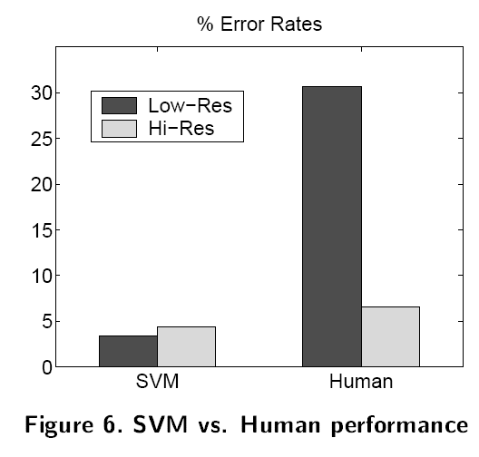
Human vs. Machine
SVMs performed better than any single human test subject, at either resolution

Slide 79
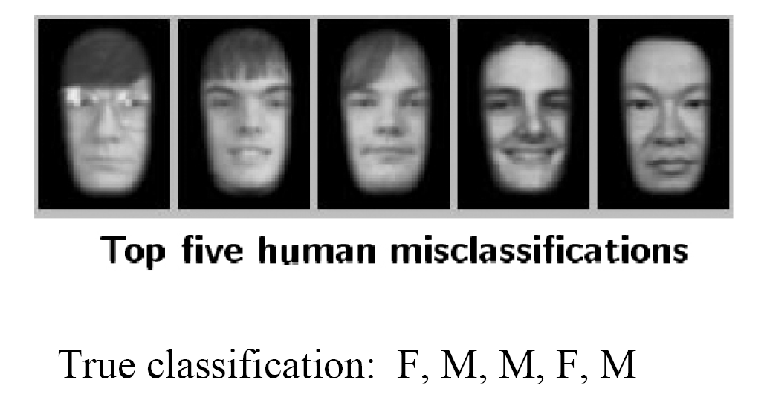
Hardest examples for humans
Moghaddam and Yang, Face & Gesture 2000.

Slide 80
Questions
What if the features are not 2d?
What if the data is not linearly separable?
What if we have more than just two categories?

Slide 81
Multi-class SVMs
Achieve multi-class classifier by combining a number of binary classifiers
One vs. all
Training: learn an SVM for each class vs. the rest
Testing: apply each SVM to test example and assign to it the class of the SVM that returns the highest decision value
One vs. one
Training: learn an SVM for each pair of classes
Testing: each learned SVM “votes” for a class to assign to the test example

Slide 82
SVMs: Pros and cons
Pros
Many publicly available SVM packages: http://www.kernel-machines.org/software
http://www.csie.ntu.edu.tw/~cjlin/libsvm/
Kernel-based framework is powerful, flexible
Often a sparse set of support vectors – compact at test time
Work very well in practice, even with very small training sample sizes
Cons
Can be tricky to select best kernel function for a problem
Computation, memory
During training time, must compute matrix of kernel values for every pair of examples
Learning can take a very long time for large-scale problems
Adapted from Lana Lazebnik

Slide 83
Questions?
See you Tuesday!

